Slide 1
Making Sense Presentation
April 6th
AI Survey Team

Slide 2
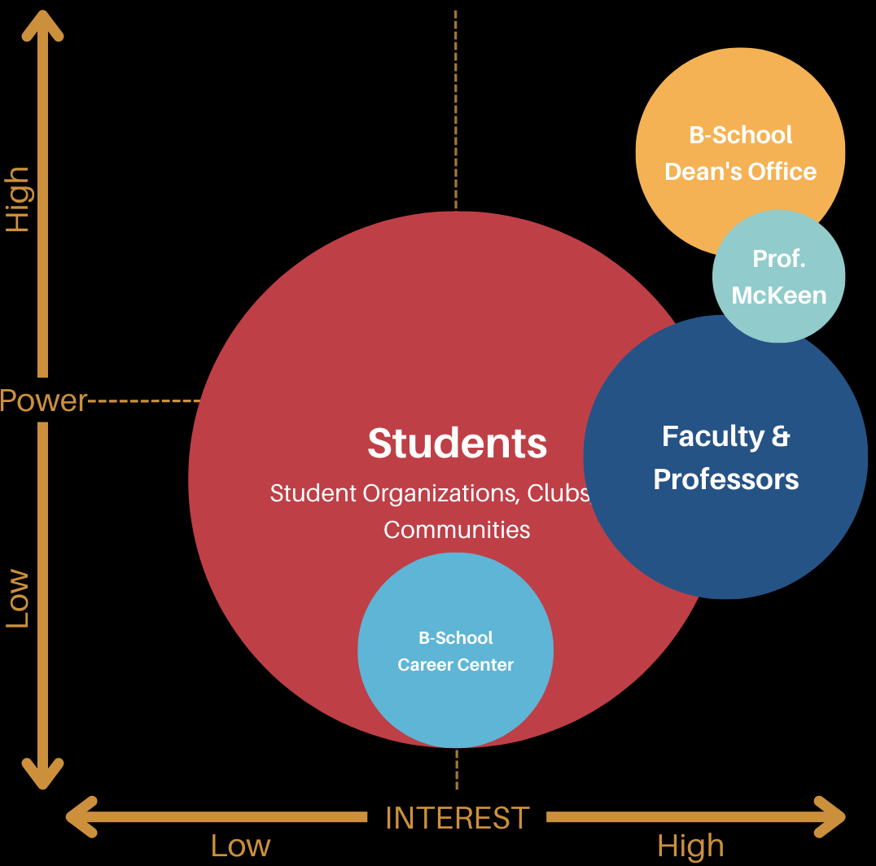
Stakeholder Analysis
Students: various interest levels and various degrees of power
Faculty & Professors: direct drivers but with various degrees of power
Dean’s Office: key driver with high interest and high power
Career Center: goals align with that of students’
Prof. McKeen: client and direct advisor to AI-related policy changes, with high power and high interest
Notes:
Zhanyi AACSB

Slide 3

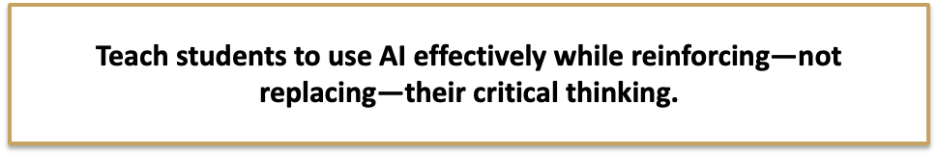
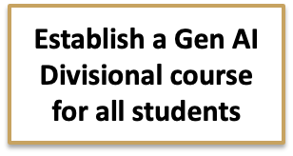
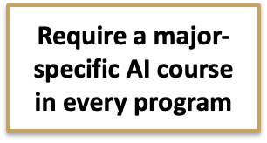
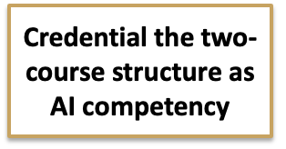

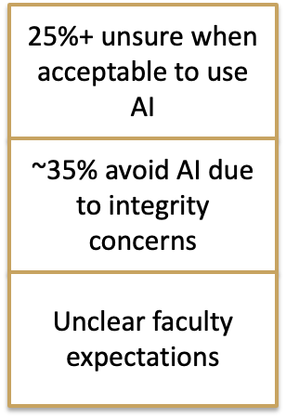
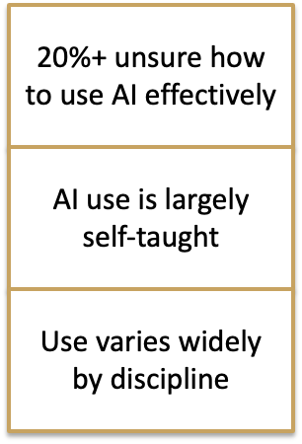
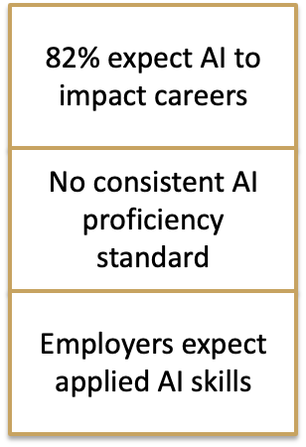
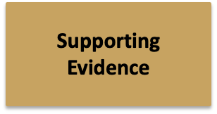
Notes:
Rhyan
We've structured our recommendations using the Pyramid format, one governing though of teaching students how to use AI effectively while reinforcing, not replacing critical thinking, three conclusions, each grounded in evidence. This format aligns with the three categories we've separated our analysis into throughout this project: academic integrity, critical thinking, and workforce preparedness.
Each conclusion or recommendation we will make to our client stems directly from our framing question and governing thought — of how to prepare business students for an AI driven work force without compromising critical thinking ability.. The three conclusions you see here each address one of those categories, and we'll walk through the supporting evidence for each in the slides ahead.

Slide 4
Establish a Gen AI Foundations course as a divisional requirement for all students.
Key Points
Credit-bearing requirement for all students
Business School Prerequisite
Standards for ethics, disclosure & appropriate use
Why This Matters
~35% report avoiding AI over academic honesty fears
~25% report being unsure when AI use is allowed
Students indicated demand for (n=349):
Guidelines from professors (190) | AI verification training (157) | Prompting support (137)
Remove ambiguity. Align student and faculty expectations.
Notes:
Rhyan
Our data makes a clear case for establishing a Gen AI Foundations course as a divisional requirement that would create a shared baseline for all students in their understanding of appropiate Ai use in terms of ethics and AI literacy, before entering a major course. This removes the ambiguity that leads to inconsistent behaviors across departments.
Right now, students are arriving in their courses without a shared understanding of how AI should, and shouldn't, be used. About 35% of business school students are avoiding AI tools altogether out of fear of academic dishonesty, and a quarter aren't sure when use is even permitted
Students are reporting they want this support. Of the 349 business students surveyed, the top needs were clear: professor guidelines, verification training, and prompting support. These numbers indicate students asking for university support in clearing up faculty expectations around responsible Ai use and ultimately aligning student and faculty expectations.
Furthermore, further evidence from the open response question about AI’s role in higher education is:
“I think courses on AI, access to AI tools, frequent news, clear expectations, and guidelines are all essential.”
“I think the role of the university education system with regard to Gen AI is to clarify expectations to avoid confusion, ensure honor compliance, improve security and ensure the integrity of AI information… I look to Wake to help set the standards and policies as we move toward the adoption of this new technology.”

Slide 5
Complement the divisional requirement with a major-specific AI course embedded in every program's curriculum.
Key Points
Required, credit-bearing course for all business school students depending on their major
Prepare students for using AI in their entry level job
Tailored towards that field’s necessary skills
Why This Matters
~82% report belief that Gen AI will affect their professional roles after graduation and 78% feel prepared
Q27: “I think we need to be trained on how to use it so that we can be prepared for the world, but we should never rely on it for learning.”
Q27: “It’s the future of our world and if you don’t embrace the change, you will get left behind… Everyone will use it in their jobs after college, so we should start preparing now.”
Peer Institution Data
Nationally (IHE 2025): only 16% of students think AI preparation should be left to individual professors
Notes:
Kevin
Students feel confident that AI will affect their job, they feel prepared for that disruption, but that preparedness is fully self reported with no university guidance or instruction leading to that confidence. So in reality, students that feel prepared may actually not be prepared for the AI led disruption in the workforce that they believe is coming
Students want institutional response not class by class

Slide 6
Frame the two-course structure, divisional plus major-specific, as a marketable, credentialed competency.
Key Points
Signal to employers that graduates meet a defined proficiency standard
Position Wake Forest as a leader in graduate workforce readiness
Why This Matters
~82% students report a belief that AI will affect their professional roles
The World Economic Forum's 2025 Skills Report found that 74% of employers prefer candidates with verified digital skills credentials for AI-related roles
Peer Institution Data
UNC AI Usage Survey: 79% of UNC staff agreed that developing AI skills would make them more marketable throughout their careers
Q27: “My job after graduation specifically asked me how I use AI, and I believe that being “AI-fluent” will be one of the most important skills a student can have going forward.”
Notes:
Kevin
UNC stat - we don’t have faculty data but this sentiment aligns with our recommendation
On the bottom is a quote from a student who was consistently asked in interviews how AI fluent they are. They cited not having an AI credential to speak to as something that could have helped him out in these interviews

Slide 7
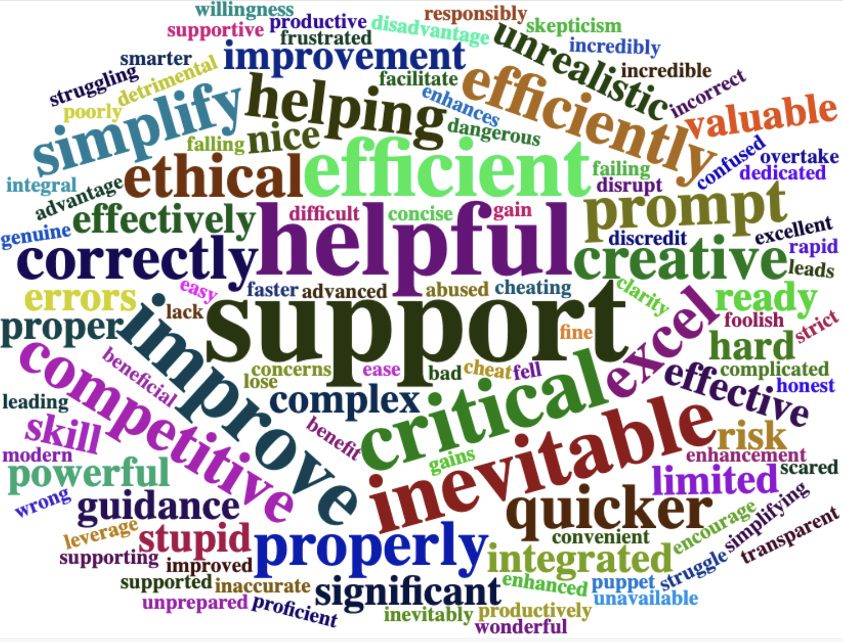
Notes:
Bjorn

Slide 8
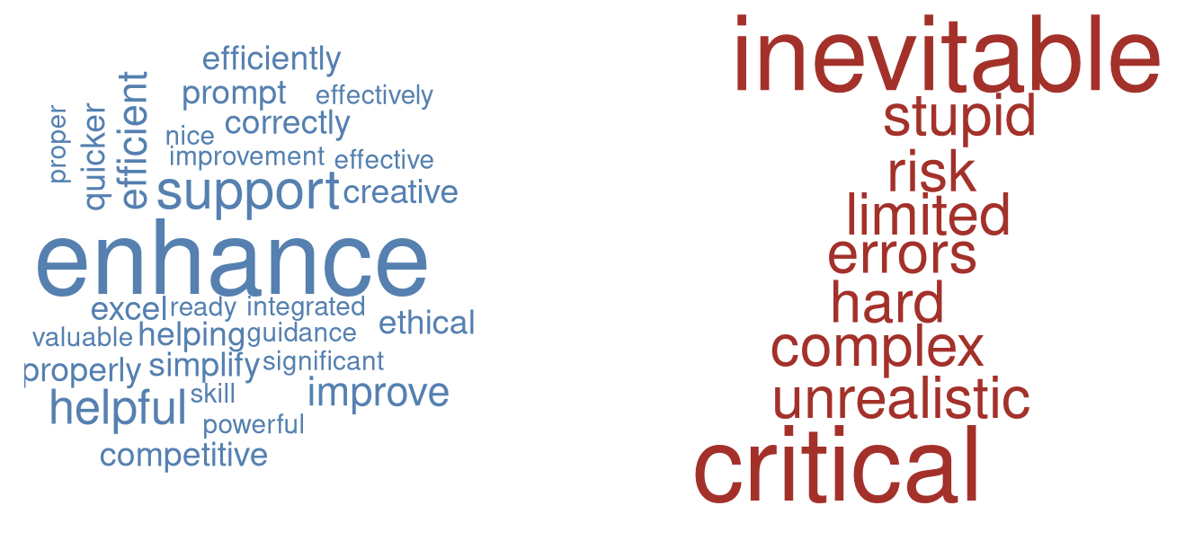
Notes:
Bjorn

Slide 9
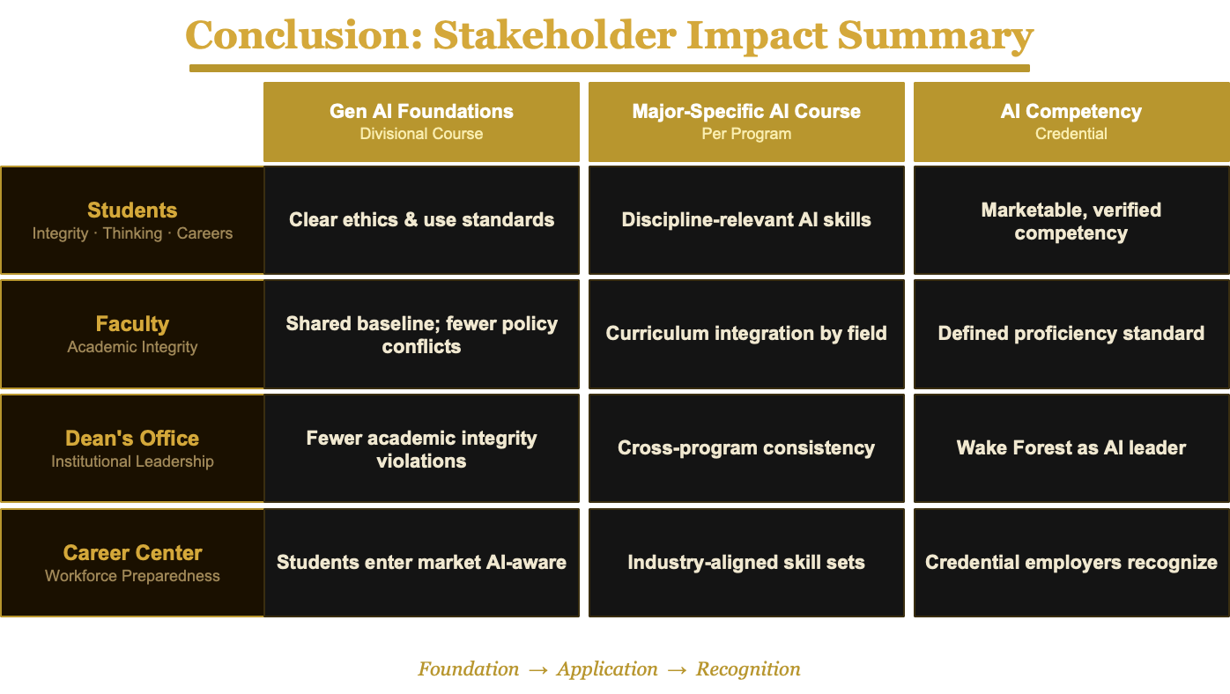
Notes:
Zhanyi

Slide 10
Thank You!

